Slide 1
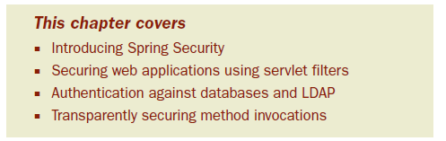
Chapter 9: Securing Spring
As software developers, we must take steps to protect the information that resides in our applications.
Security is a crucial aspect of most applications.
Notes:
-Whether it’s an email account protected with a username/password pair or a brokerage account protected with a trading PIN,

Slide 2
For the most part, an application should play no part in securing itself.
It’s better to keep security concerns separate from application concerns.
In this chapter we’re going to explore ways to secure your applications with aspects.
But we won’t have to develop those aspects ourselves—we’re going to look at Spring Security, a security framework implemented with Spring AOP and servlet filters

Slide 3
9.1 Introducing Spring Security
Spring Security is a security framework that provides declarative security for your Spring-based applications.
Spring Security provides a comprehensive security solution, handling authentication and authorization at both the web request level and at the method invocation level.
Dependency injection (DI) and aspect-oriented techniques.

Slide 4
Spring Security got its start as Acegi Security.
  required a lot of XML configuration
With version 2.0, Acegi Security became Spring Security.
Spring Security 2.0 introduced a new security-specific XML namespace for configuring security in Spring.
Spring Security 3.0, the most recent release, added SpEL to the mix, simplifying security configu-ration even more.

Slide 5
To secure web requests and restrict access at the URL level, Spring Security uses servlet filters.
Spring Security can also secure method invocations using Spring AOP—proxying objects and applying advice that ensures that the user has proper authority to invoke secured methods.

Slide 6
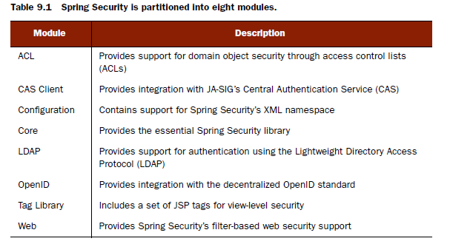
9.1.1 Getting started with Spring Security
The first thing to do is to add the Spring Security modules to the application’s classpath
Notes:
-At the least, you’ll want to include the Core and Configuration modules in your application’s classpath.
-Spring Security is often used to secure web applications. That’s cer-tainly the case with the Spitter application, so we’ll also need to add the web module.
-We’ll also be taking advantage of Spring Security’s JSP tag library, so we’ll need to add that module to the mix.

Slide 7
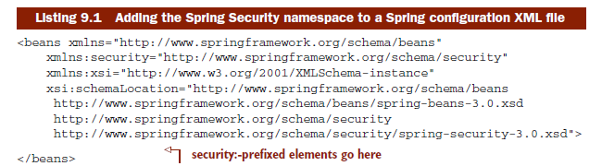
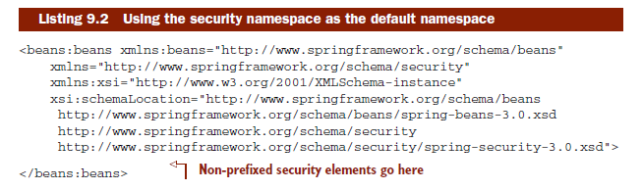
9.1.2 Using the Spring Security configuration namespace

Slide 8
Exercise 9-1
  Write spitter-security.xml
  Declare the security namespace as primary

Slide 9
9.2 Securing web requests
If the request is the access point to a web application, then that’s where security for a web application should begin.
The most basic form of request-level security involves declaring one or more URL patterns as requiring some level of granted authority and preventing users without that authority from accessing the content behind those URLs.
Taking it a step further, you may want to require that certain URLs can only be accessed over HTTPS.

Slide 10
To get started with web security in Spring, we must set up the servlet filters that provide the various security features.

Slide 11
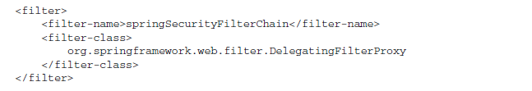
9.2.1 Proxying servlet filters
Spring Security employs several servlet filters to provide various aspects of security.
Spring-magic: we’ll only need to configure one filter in the application’s web.xml file

Slide 12
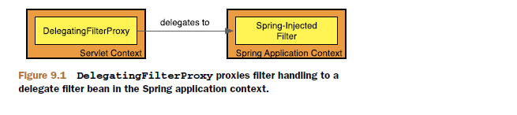
DelegatingFilterProxy is a special servlet filter that, by itself, doesn’t do much. Instead, it delegates to an implementation of javax.servlet.Filter that’s registered as a <bean> in the Spring application context

Slide 13
The value given as DelegatingFilterProxy’s <filter-name> is significant. This is the name used to look up the filter bean from the Spring application context.
Spring Security will automatically create a filter bean whose ID is springSecurityFilterChain, so that’s the name we’ve given to DelegatingFilterProxy in web.xml

Slide 14
As for the springSecurityFilterChain bean itself, it’s another special filter known as FilterChainProxy
It’s a single filter that chains together one or more additional filters.
Spring Security relies on several servlet filters to provide different security features- no need to know these details
Spring Security will automatically create the beans for us when we configure the <http> element

Slide 15
Exercise 9-2
  Add the needed filter to web.xml

Slide 16

9.2.2 Configuring minimal web security
These humble three lines of XML configure Spring security to intercept requests for all URLs and restrict access to only authenticated users who have the ROLE_SPITTER role.
The <http> element automatically sets up a FilterChainProxy (which is delegated to by the DelegatingFilterProxy we configured in web.xml) and all of the filter beans in the chain

Slide 17
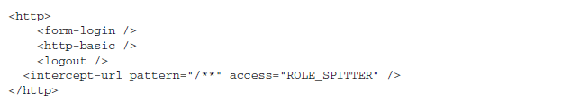
Autoconfiguration gives our application a free login page, support for HTTP Basic authentication, and support for logging out

Slide 18
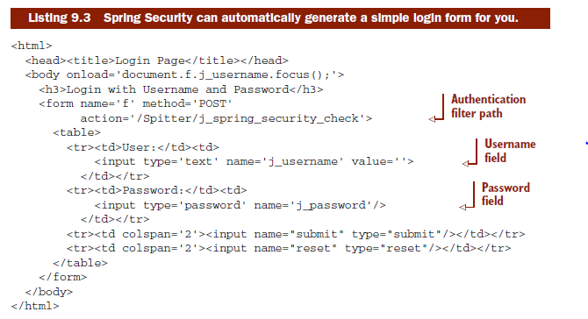
LOGGING IN VIA A FORM
One of the benefits of setting auto-config to true is that Spring Security will automatically generate a login page for you. Here’s the HTML for that form.

Slide 19

To put our own login page in place, we’ll need to configure a <form-login> element to override the default behavior
The login attribute specifies a new context-relative URL for the login page. In this case we state that the login page will reside at /login which is ultimately handled by a Spring MVC controller.

Slide 20
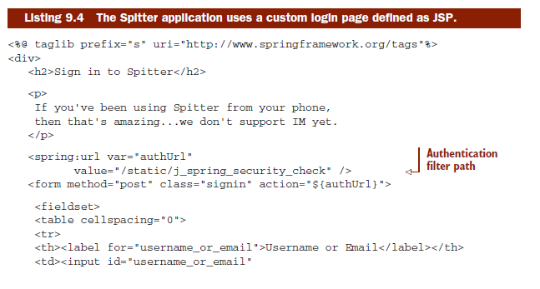
Note that we’ve set the login-processing-url to /static/j_spring_security_ check. This is the URL that the login form will submit back to to authenticate the user.

Slide 21
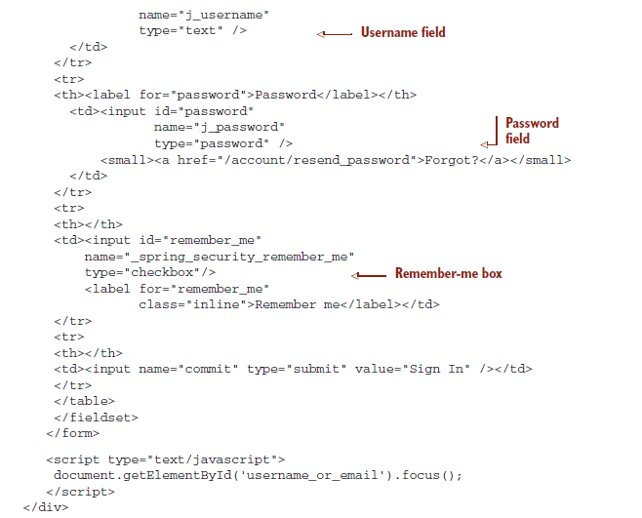

Slide 22
HANDLING BASIC AUTHENTICATION
HTTP Basic authentication is a way to authenticate a user to an application directly in the HTTP request itself.
HTTP Basic authentication is either turned on or it’s not.
  <http-basic/>

Slide 23
LOGGING OUT
The <logout> element sets up a Spring Security filter that will invalidate a user session.
When used as is, the filter set up by <logout> is mapped to /j_spring_security_ logout.

Slide 24
9.2.3 Intercepting requests
The <intercept-url> element is the first line of defense in the request-level security game.
You can use as many <intercept-url> entries as you like to secure various paths in your web application. But it’s important to know that the <intercept-url> rules are applied top to bottom.

Slide 25
SECURING WITH SPRING EXPRESSIONS
Listing required authorities is simple enough, but it’s somewhat one-dimensional. What if you wanted to express security constraints that are based on more than just granted privileges?
As of version 3.0, Spring Security also supports SpEL as a means for declaring access requirements.

Slide 26

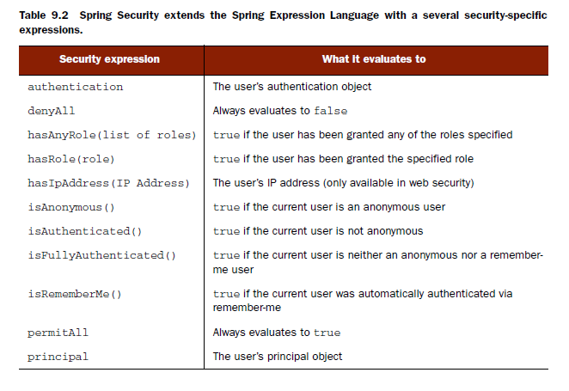

Slide 27
With SpEL-based security constraints, the possibilities are virtually endless.

Slide 28
FORCING REQUESTS TO HTTPS
Submitting data across HTTP can be a risky proposition.
Sensitive information should be sent encrypted over HTTPS.
The <intercept-url> element’s requires-channel attribute shifts the responsibility for channel enforcement into the Spring Security configuration.

Slide 29
Exercise 9-3
  Configure spitter application so that all request URL’s will require authentication
  Reconfigure spitter application so that request URL ‘/home should require role ‘ROLE_SPITTER’
    Specify logout-url to invalidate user session
    Try forcing requests to https

Slide 30
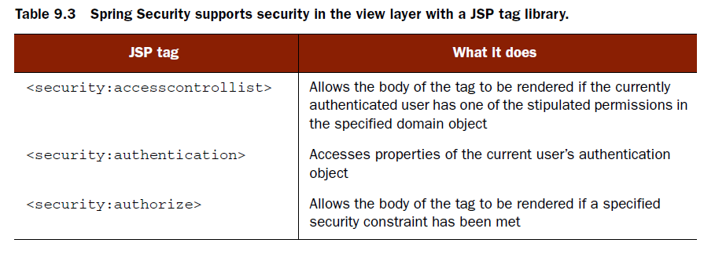
9.3 Securing view-level elements
To support security in the view layer, Spring Security comes with a JSP tag library.

Slide 31
9.3.1 Accessing authentication details
One of the simplest things that the Spring Security JSP tag library can do for us is provide convenient access to the user’s authentication information.

Slide 32
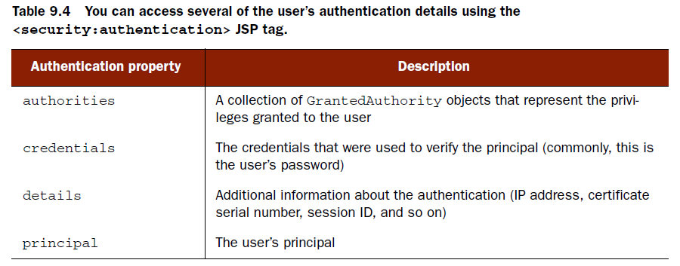

Slide 33
9.3.2 Rendering with authorities
Sometimes portions of the view should or shouldn’t be rendered, depending on what the user is privileged to do.
Spring Security’s <security:authorize> JSP tag conditionally renders a portion of the view depending on the user’s granted authorities.

Slide 34
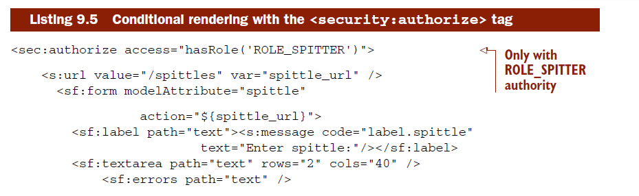
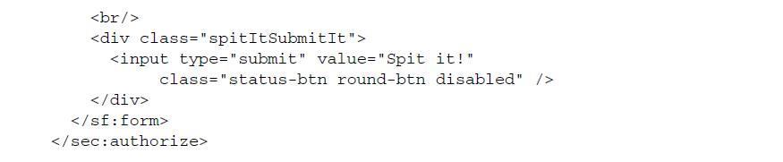

Slide 35
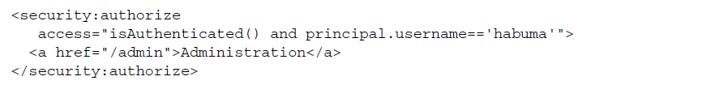
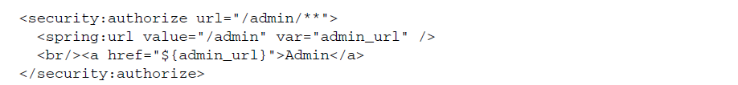
But to do that we had to declare the SpEL expression in two places—in <intercept-url> and in the <security:authorize> tag’s access attribute.
Notes:
Sure, it’ll keep the link from being rendered in the view. But nothing’s stopping anyone from manually entering the /admin URL in the browser’s address line.

Slide 36
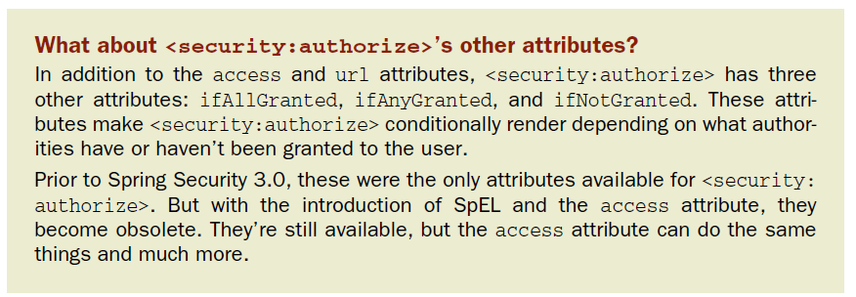

Slide 37
Exercise 9-4
  Only spitters with role: ROLE_SPITTER should be able to enter spittle(spittleForm.jsp)
  If user is already logged-in, sign-in form (signinsignup.jsp)should not show up.

Slide 38
9.4 Authenticating users
Every application’s a little different. That truth is evident in how every application stores user information. Sometimes it’s kept in a relational database. Other times it might be in an LDAP-enabled directory. Some applications rely on a decentralized user identity system. And some may employ more than one strategy.

Slide 39
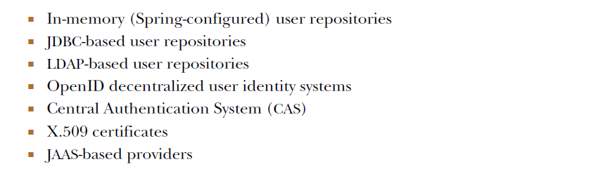

Slide 40
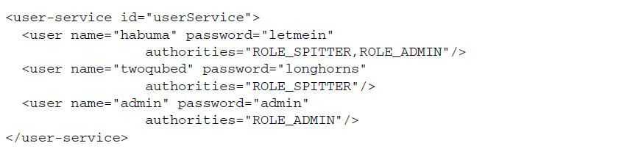

9.4.1 Configuring an in-memory user repository

Slide 41
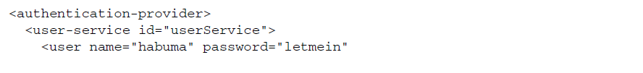
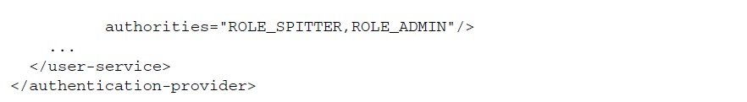
The <authentication-manager> element registers an authentication manager. More specifically, it registers an instance of ProviderManager, an authentication manager that delegates authentication responsibility to one or more authentication providers.

Slide 42
Exercise 9-4
  Configure spitter application so it will be using in-memory authentication

Slide 43

9.4.2 Authenticating against a database

Slide 44
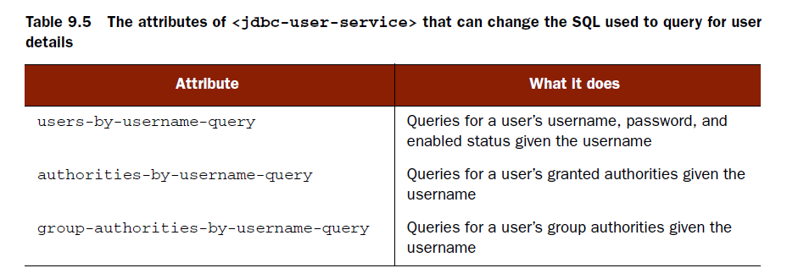
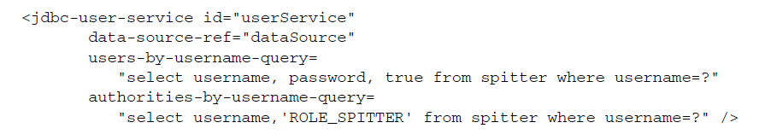

Slide 45
9.4.3 Authenticating against LDAP
Most organizations are structured hierarchically. Employees report to supervisors, supervisors to directors, direc- tors to vice presidents, and so forth.
LDAP directories excel at storing information hierarchically.
Alongside, you’ll often find the company’s security constraints mapped to the entries in the directory.

Slide 46
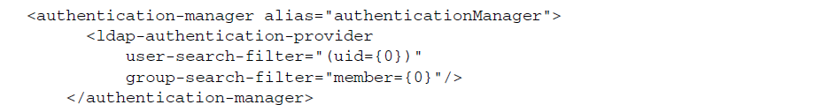
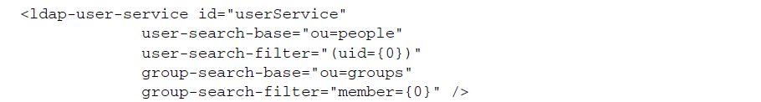
When it comes to configuring LDAP authentication, we have two choices:
  With an LDAP-oriented authentication provider
  With an LDAP-oriented user service
Notes:
The user-search-base attribute provides a base query for finding users.
Likewise, the group-search-base specifies the base query for finding groups.
Rather than search from the root, we’ve specified that users be searched for where the organization unit is people.
And groups should be searched for where the organizational unit is groups.
By default, the base queries for both users and groups are empty, indicating that the search will be done from the root of the LDAP hierarchy.

Slide 47
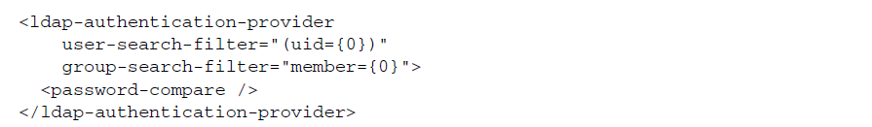
CONFIGURING PASSWORD COMPARISON
The default strategy to authenticate against LDAP is to perform a bind operation, authenticating the user directly to the LDAP server.
Another option is to perform a comparison operation.
If you’d rather authenticate by doing a password comparison, you can do so by declaring so with the <password-compare> element:

Slide 48
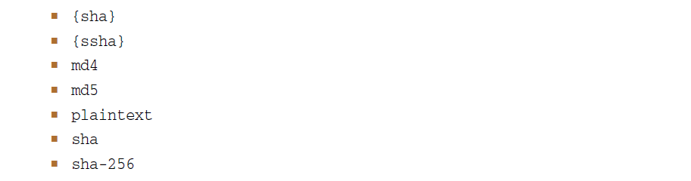
As declared here, the password given in the login form will be compared with the value of the userPassword attribute in the user’s LDAP entry. If the password is kept in a different attribute, then specify the password attribute’s name with password- attribute:

Slide 49
By default, Spring Security’s LDAP authentication assumes that the LDAP server is listening on port 33389 on localhost. But if your LDAP server is on another machine, then you can use the <ldap-server> element to configure the location:

Slide 50
CONFIGURING AN EMBEDDED LDAP SERVER
When the LDAP server starts, it will attempt to load data from any LDIF files that it can find in the classpath. LDIF (LDAP Data Interchange Format) is a standard way of representing LDAP data in a plain text file.

Slide 51
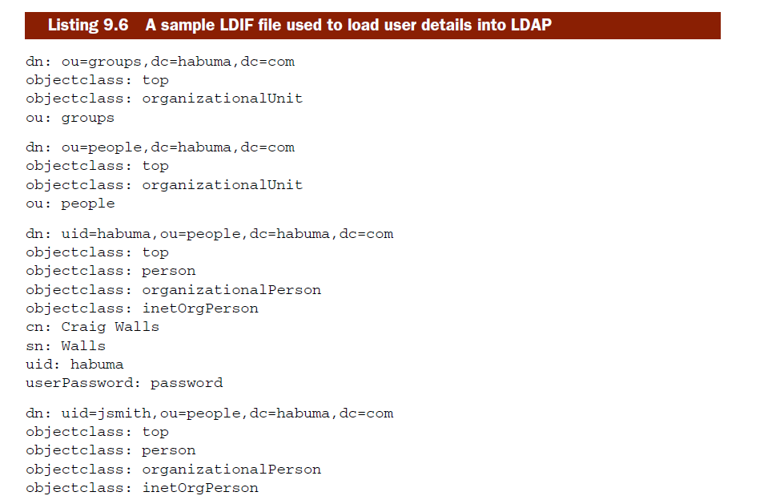

Slide 52
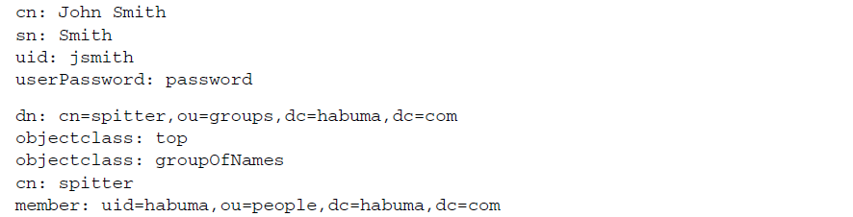

Slide 53
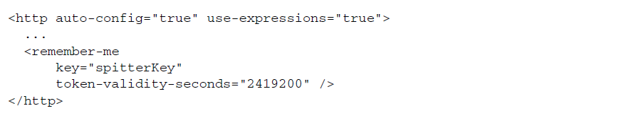
9.4.4 Enabling remember-me functionality
If you use the <remember-me> element with no attributes, this feature is accomplished by storing a token in a cookie that’s valid for up to two weeks.
The token that’s stored in the cookie is made up of the username, password, an expiration date, and a private key—all encoded in an MD5 hash before being written to the cookie.

Slide 54
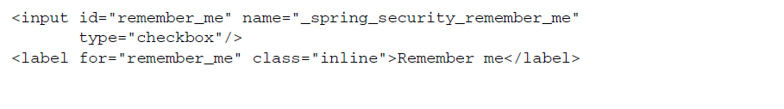

Slide 55
9.5 Securing methods
  Methods annotated with @Secured
  Methods annotated with JSR-250’s @RolesAllowed
  Methods annotated with Spring’s pre- and post-invocation annotations
  Methods matching one or more explicitly declared pointcuts

Slide 56
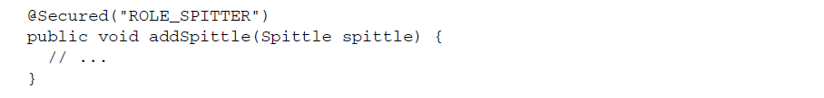
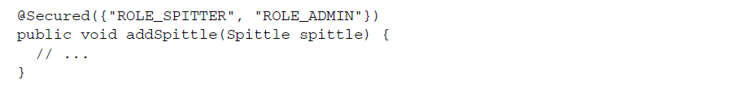
9.5.1 Securing methods with @Secured
The @Secured annotation takes an array of String as an argument.
If more than one value is passed into @Secured, then the authenticated user must be granted at least one of those authorities to gain access to the method.
Notes:
When <global-method-security> is configured with its secured-annotations attribute set to enabled, a pointcut is created such that the Spring Security aspects will wrap bean methods that are annotated with @Secured.

Slide 57
When the method is invoked by an unauthenticated user or by a user not possessing the required privileges, the aspect wrapping the method will throw one of Spring Security’s exceptions (probably a subclass of AuthenticationException or AccessDeniedException).

Slide 58
9.5.2 Using JSR-250’s @RolesAllowed
The @RolesAllowed annotation is equivalent to @Secured in almost every way.

Slide 59
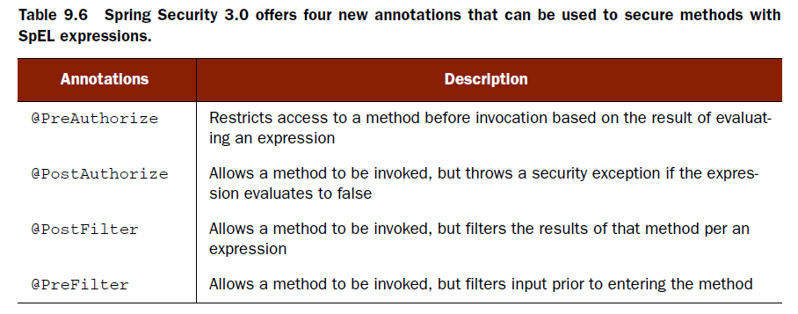
9.5.3 Pre-/Post-invocation security with SpEL
Spring Security 3.0 introduced a handful of new annotations that use SpEL to enable even more interesting security constraints on methods.

Slide 60
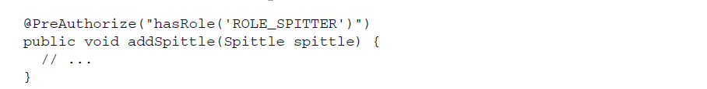
PRE-AUTHORIZING METHODS

Slide 61
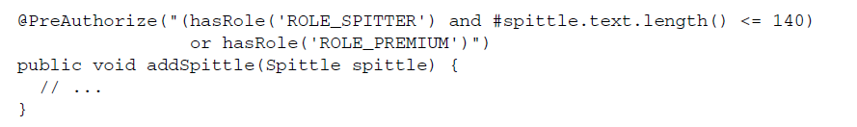
With SpEL expressions guiding access decisions, far more advanced security con- straints can be written. For example, suppose that the average Spitter user can only write spittles of 140 characters or less, but premium users are allowed unlimited spittle lengths.

Slide 62

POST-AUTHORIZING METHODS
For example, suppose that we want to secure the getSpittleById() method to only authorize access if the Spittle object returned belongs to the authenticated user.
On the other side of the double-equal comparison, the expression digs into the built-in principal object to get its username property. principal is another one of Spring Security’s special built-in names that represents the principal of the currently authenticated user.

Slide 63
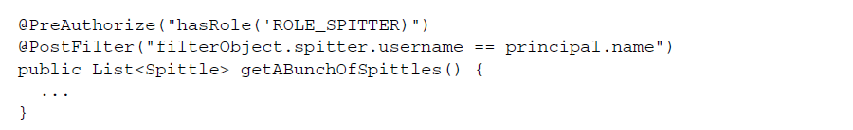
POST-FILTERING METHODS
For example, suppose that you wanted to present a list of Spittles to the user, but limit that list to only those Spittles that the user is allowed to delete.

Slide 64
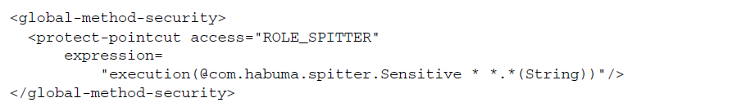
9.5.4 Declaring method-level security pointcuts
The expression attribute is given an AspectJ pointcut expression. In this case, it iden- tifies any methods that are annotated with a custom @Sensitive annotation.

Slide 65
-End of Chapter 9-

